Slide 1
Market Magician Algorithmic Trader
Artificial Asynchrony
CS691
Sep 2024
Notes:
Kassandra: introduces team and project

Slide 2
Agenda
Team Intro
Member Names
Roles and Responsibilities
Project Overview
Problem Statement
Project Description
Personas
Software Tools
Technologies
Algorithms
Team Logistics
Product Schedule
Team Working Agreement
Retrospective
Notes:
Kassandra: overview of agenda

Slide 3
Team Roles and Responsibilities
Kassandra Camarillo – Team Leader
Henry Kim – Scrum Master
Abed Mussawi – Developer
Andrew Rowan – Developer
Aviel Sanchez - Developer
Notes:
All: everyone give brief intro of name and team role

Slide 4
Problem Statement
Currently, there is a lot of interest in the stock market. Sometimes it could be confusing and daunting to invest money in the stock market since there is a lot of information and it is difficult to access. Our application will make it much easier and more accessible to the greater public to invest more wisely and with the power of data at their back.
Notes:
Andrew/Abed

Slide 5
Project Description
An AI that uses historical data, news flow, and intra-day trading data to determine entry and exit points of a stock or fund using a trained regression model in order to maximize profits.
For Daily traders and Investors
who want to improve predictive capabilities,
the web app is a tool to help both large and small capital investors and traders predict market trends faster than a human could.
This subscription service unlike hedge funds, where you need to pay a lot of money out of pocket to manage your investments, or risk trading personal funds with untested strategies,
our application provides an easy way to invest and trade your securities to minimize risk and maximize profits.
Notes:
Andrew/Abed

Slide 6

Alex Woods - Retail Investor
Age: 23
Location: Arlington, Virginia
Occupation: Nurse / recent graduate
Alex is a recent graduate who wants to start investing but has limited money and a bit of experience. She is looking for an affordable and user friendly platform that can help her enter the investment world without the need for deep financial knowledge.
Using our app will offer her personalized and ease to use market data which will make investing more accessible for beginners like Alex.
Notes:
Abed

Slide 7

Jaylen Washington - Financial Advisor
Age: 33
Location: Austin, Texas
Occupation: Financial Advisor
Jaylen is a financial advisor who assists individuals with decisions about their money. He offers advice on investments, taxes, and insurance.
Using our app will offer him a useful analysis tool that supplements his advising strategy with AI backed assessments. This could cut down on his research and analysis, saving time and money.
Notes:
Abed

Slide 8

James Smith - Hedge Fund Manager
Age: 35
Location: San Francisco, California
Occupation: hedge fund manager
James is an experienced hedge fund manager and is always on the look up for new and innovative tools to enhance his investment strategies. James understands that now a days AI models are important tools and are more efficient than using traditional methods.
Using our app will offer him cutting edge algorithms and data analysis which can be a great asset to a better investment in combination with his expertise.
Notes:
Abed

Slide 9
Technologies
Python
JavaScript
Java
Machine Learning
TensorFlow
PyTorch
HTML
CSS
Reactjs
MongoDB
Y!finance
QuantConnect
Github
VSCode
Notes:
Andrew

Slide 10
Algorithms
Linear Regression
Logistic Regression
Monte Carlo
Notes:
Andrew

Slide 11
Project Schedule
Meeting Cadence
Twice a week (Sat, Mon)
Additional meetings scheduled ad hoc based on team needs
Text Based Daily Scrum
Asynchronous team makes daily scrums impractical
Substitute with text based check in
Notes:
Henry

Slide 12
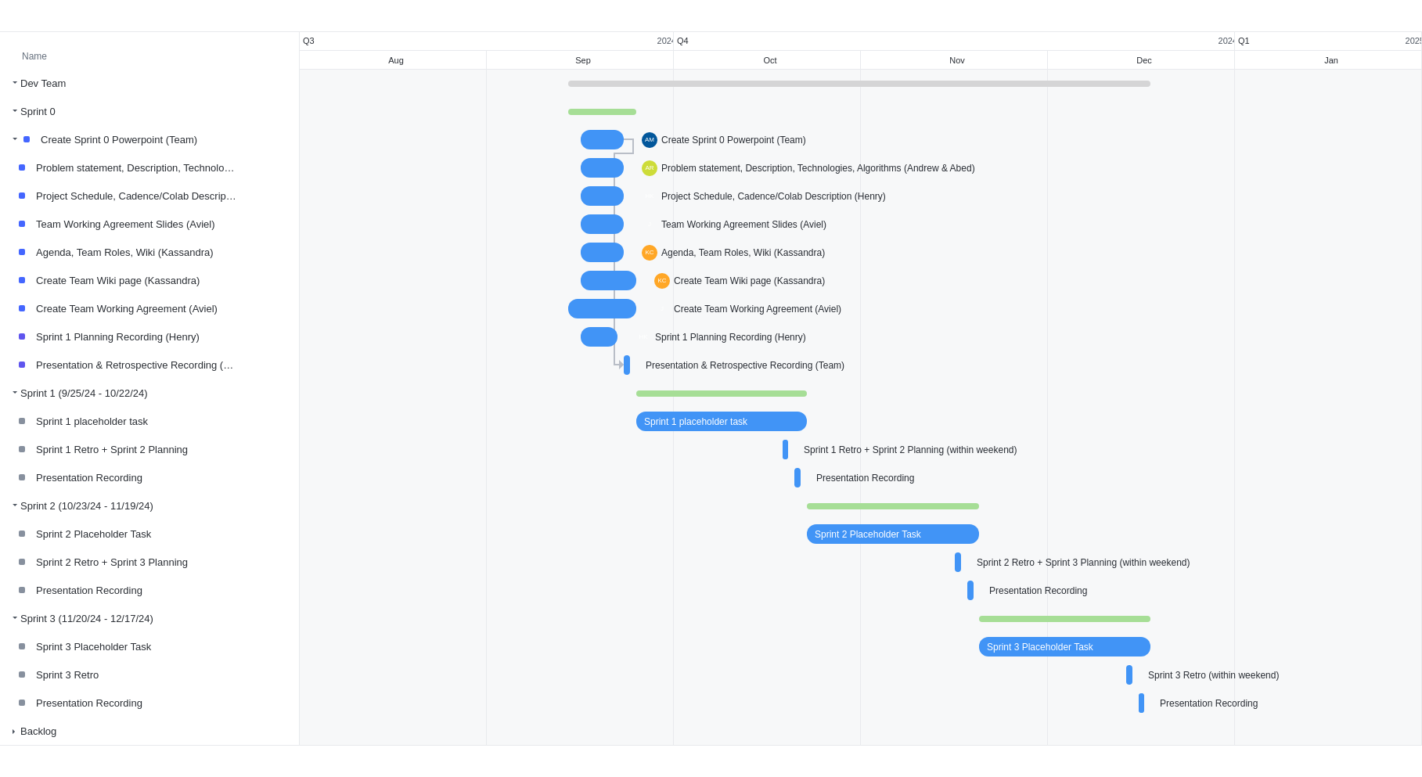
Team Gantt Chart
Notes:
Henry

Slide 13
Team Working Agreement
Scheduling meetings
Communications
Technologies used
Tentative schedule
Respect
Notes:
Avi

Slide 14
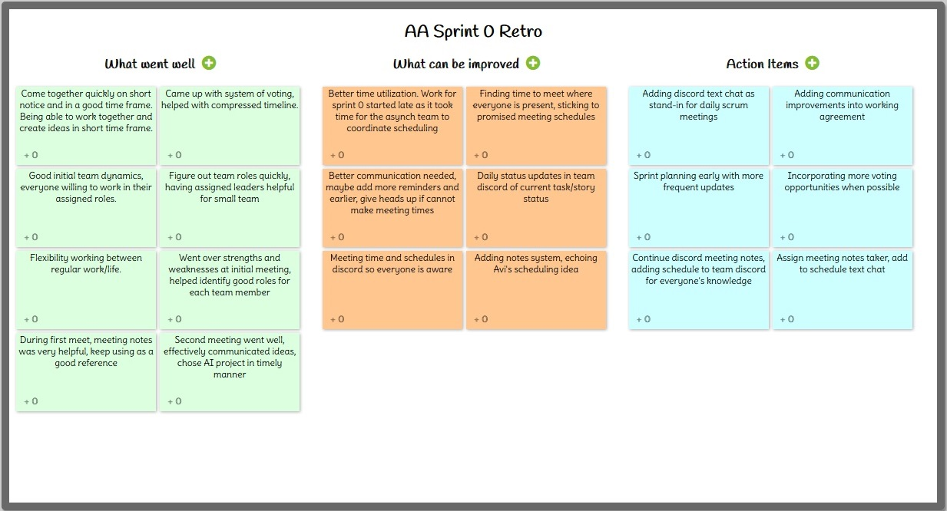
Sprint 0 Retrospective
Notes:
Henry

Slide 15
Sprint 0 Retrospective
What Went Well
Effective teamwork in compressed timeframe
Roles assigned to match member strengths
Voting methodology ensured team consensus
Needs Improvement
Team communication lacking
Allocation of available time
Lack of good meeting notes
Action Items
Add meeting schedule to team discord
Add text based “daily scrum” to team discord
Assign notes taker for each meeting
Notes:
Henry

Slide 16
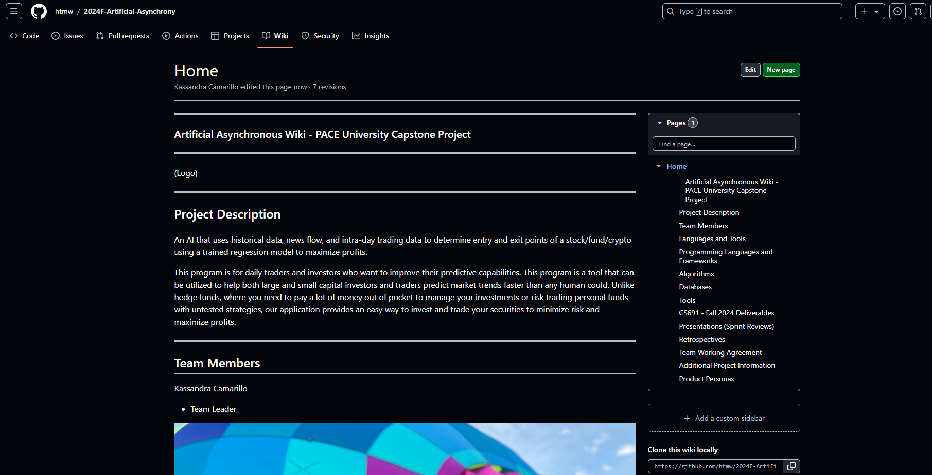
Wikipage Link
https://github.com/htmw/2024F-Artificial-Asynchrony/wiki

Slide 17
Thank you for your time

